Slide 1

A MEMS mirror scanning Lidar system
An introduction to my recent prototype project
by Zhaoxu Liu

Slide 2
1、MEMS mirror control
2、 Pulse laser driver
3、APD detector
4、TDC driver
5、Preliminary assembly and testing
6、Walk error correction
7、To be continued

Slide 3
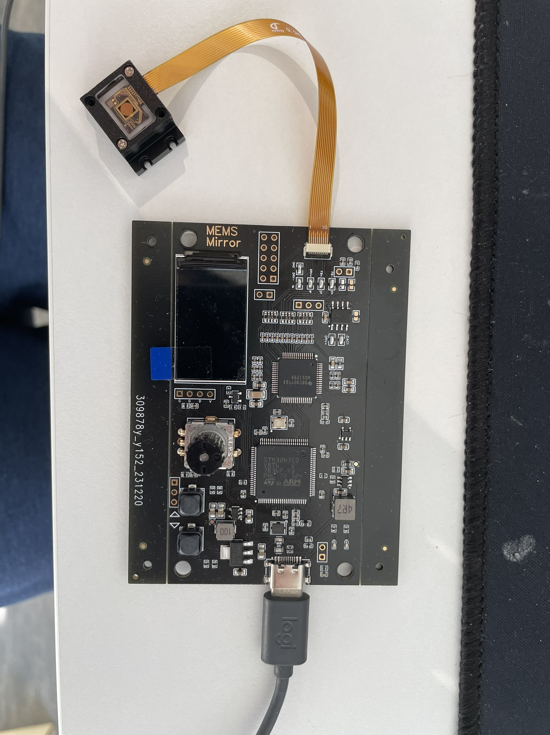
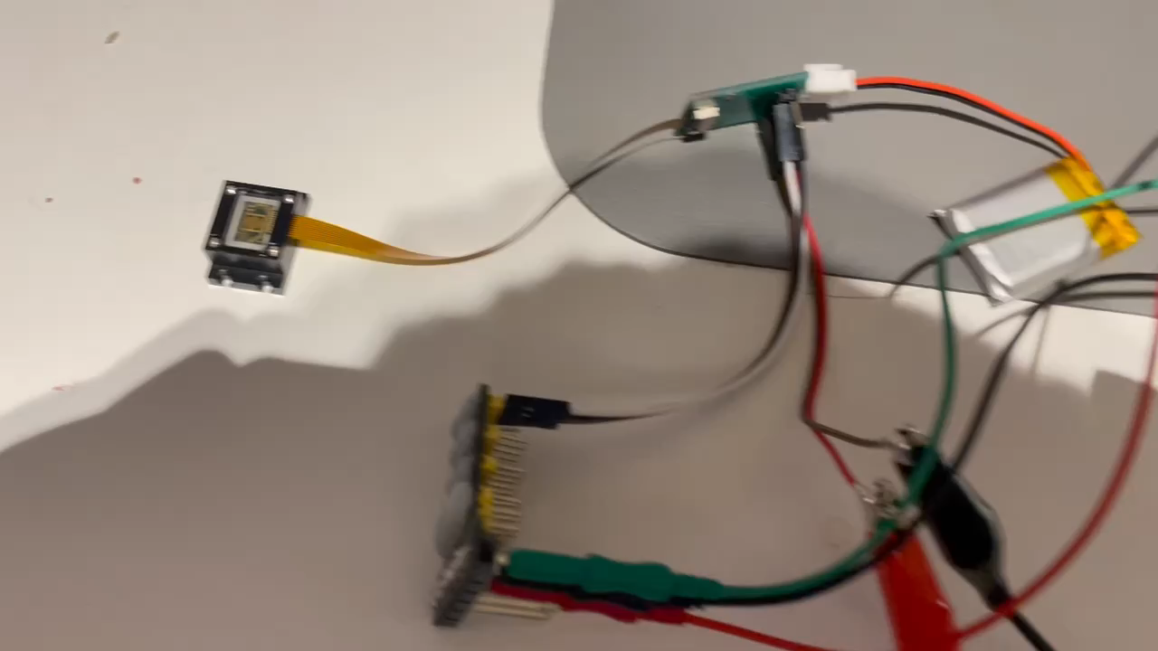
1、MEMS mirror control
Video
Build the drive control and test circuit of the MEMS mirror
the first version of the mirror control and feedback signal collection circuit

Slide 4
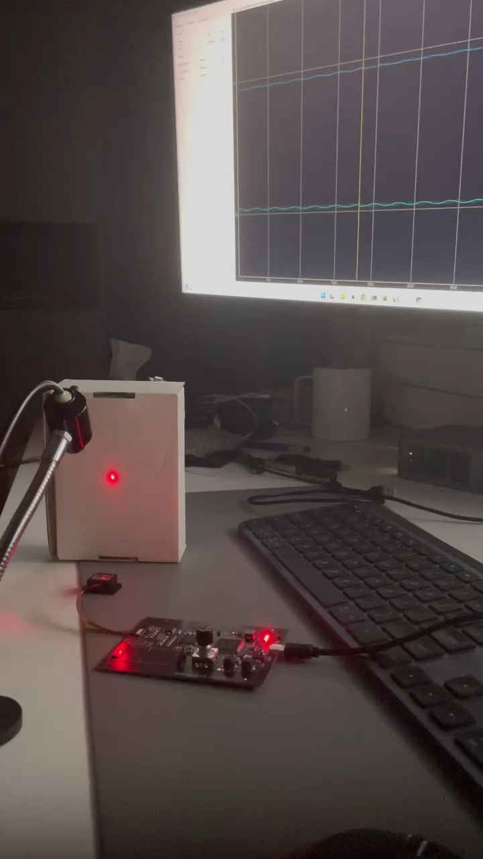
1、MEMS mirror control
Mirror Driving signal
Mirror feedback signal
scanning beam
Laser:
Just to observe a 1D scanning of the mirror
MEMS mirror
PCB:
Drive control, feedback signal collection
Video
Mirror drive control, drive/feedback signal reading and high-speed data transmission to the host computer

Slide 5
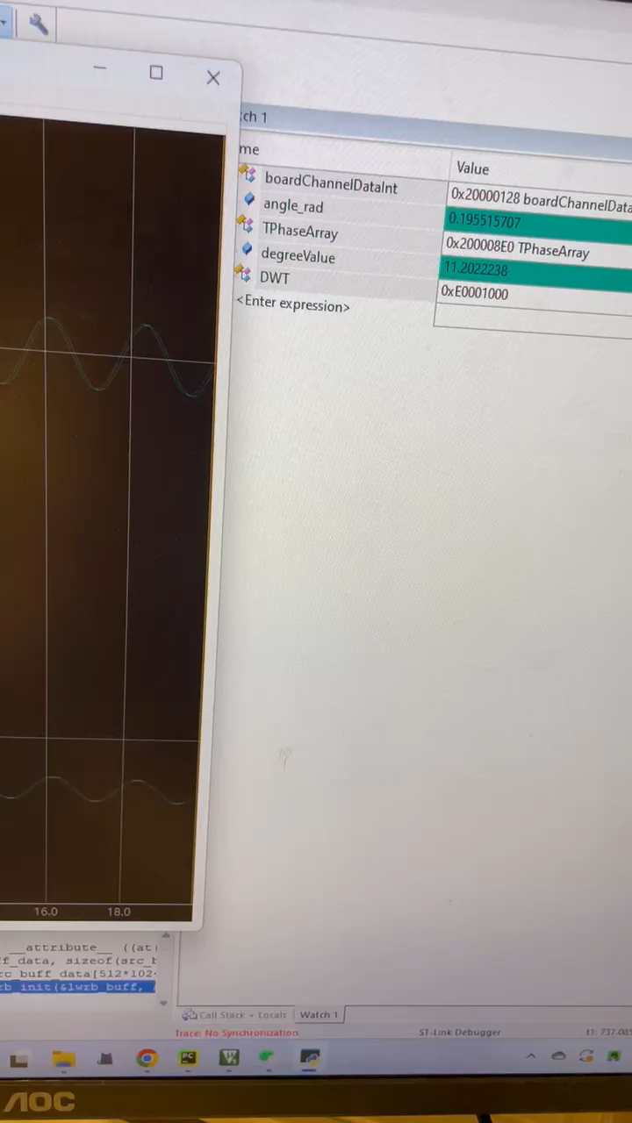
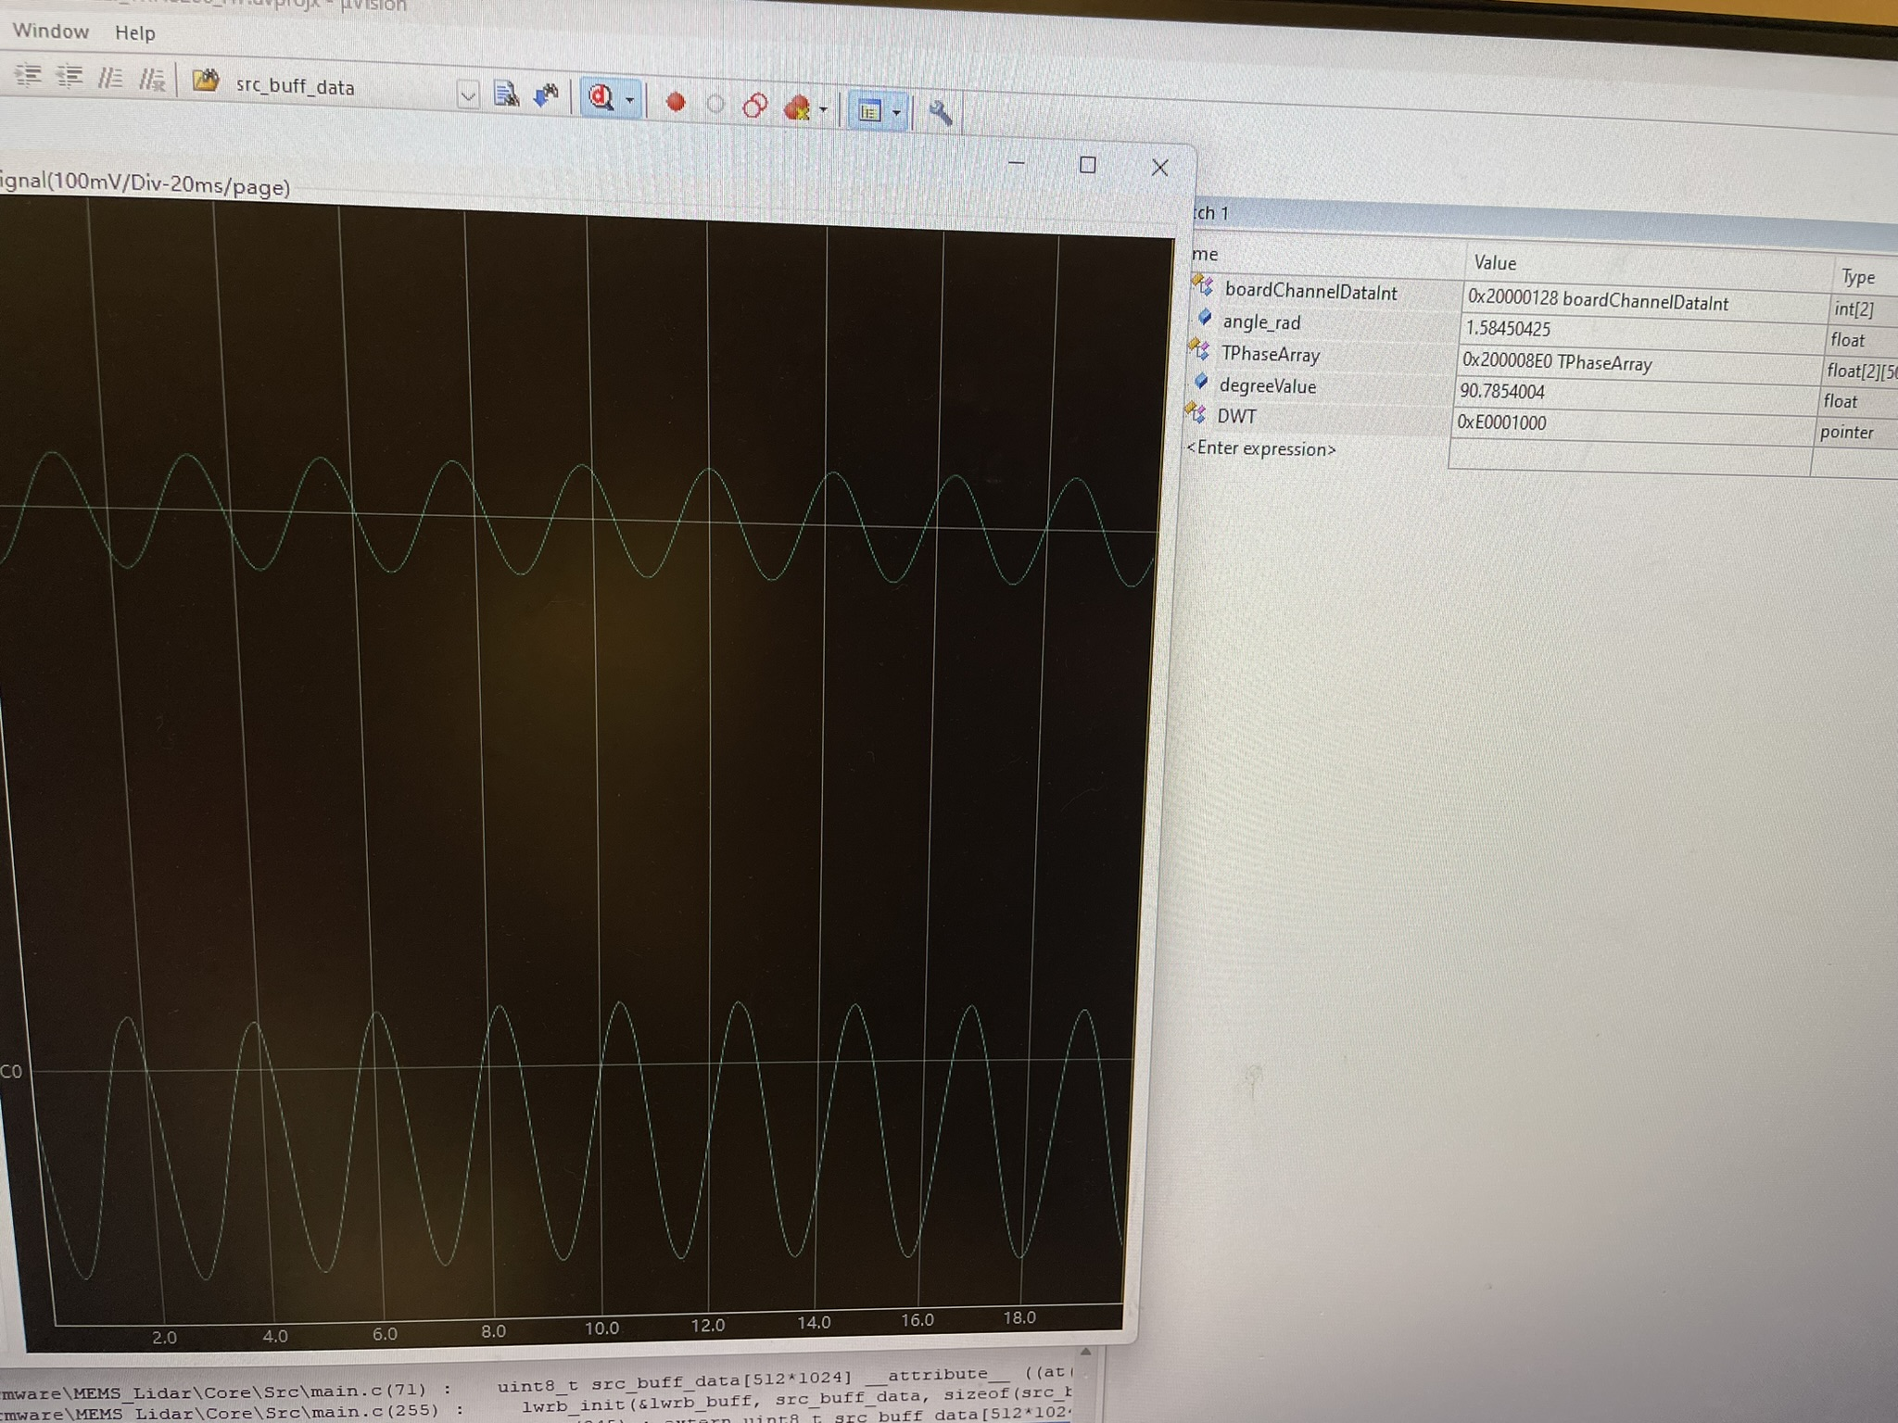
1、MEMS mirror control
Mirror feedback signal
Mirror Driving signal
High-speed synchronous acquisition of phase differences between drive and feedback signals to prepare for closed-loop control
Video
degreeValue： The phase difference of the drive/feedback signal calculated in real time

Slide 6
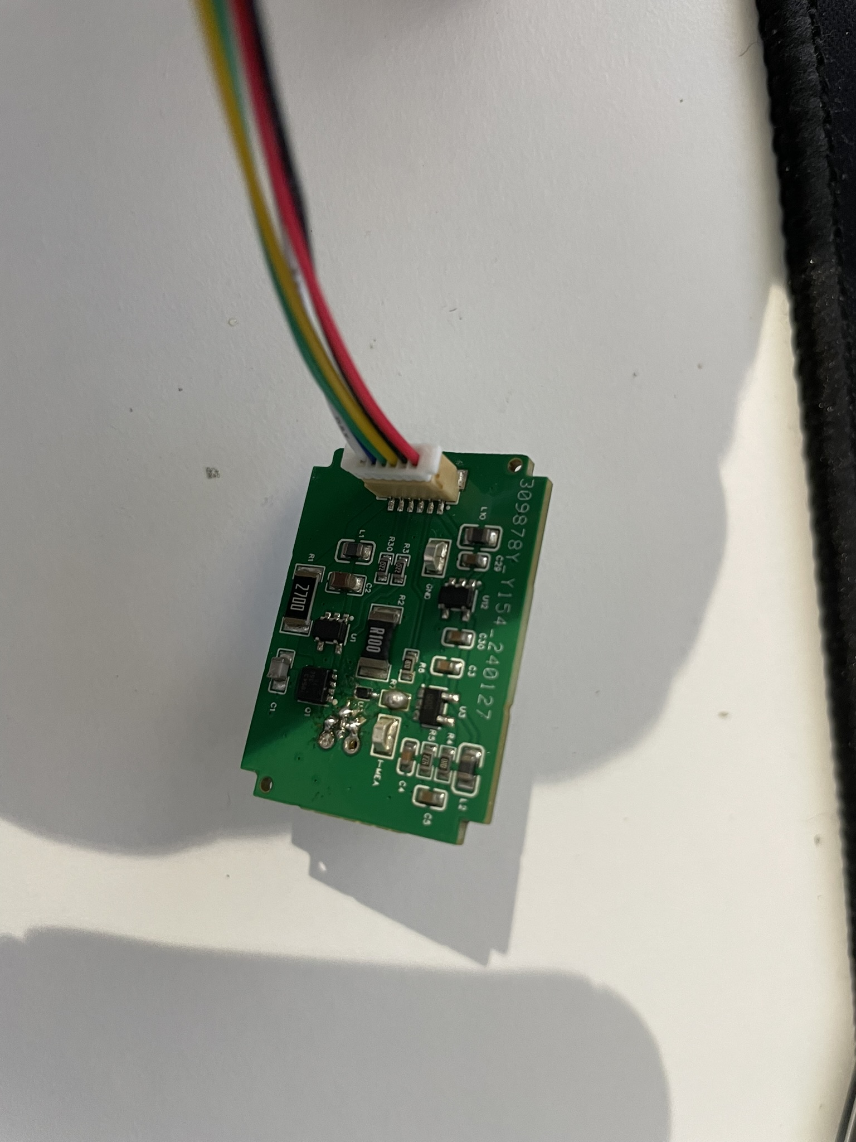
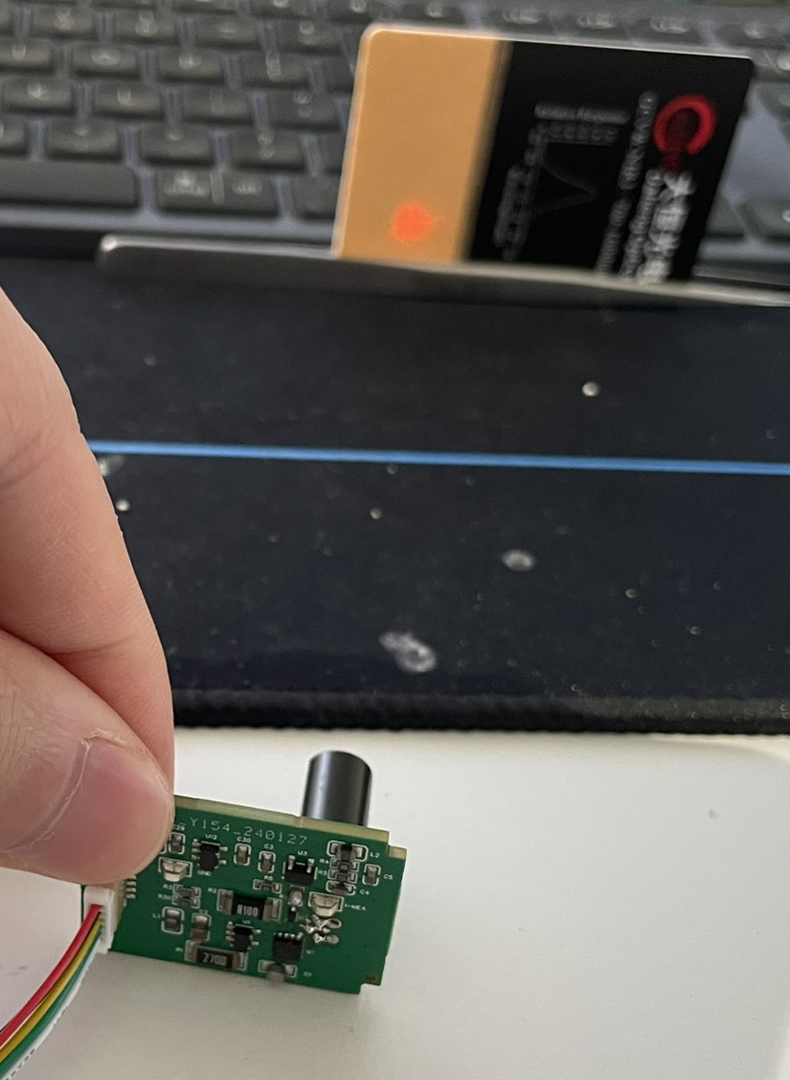
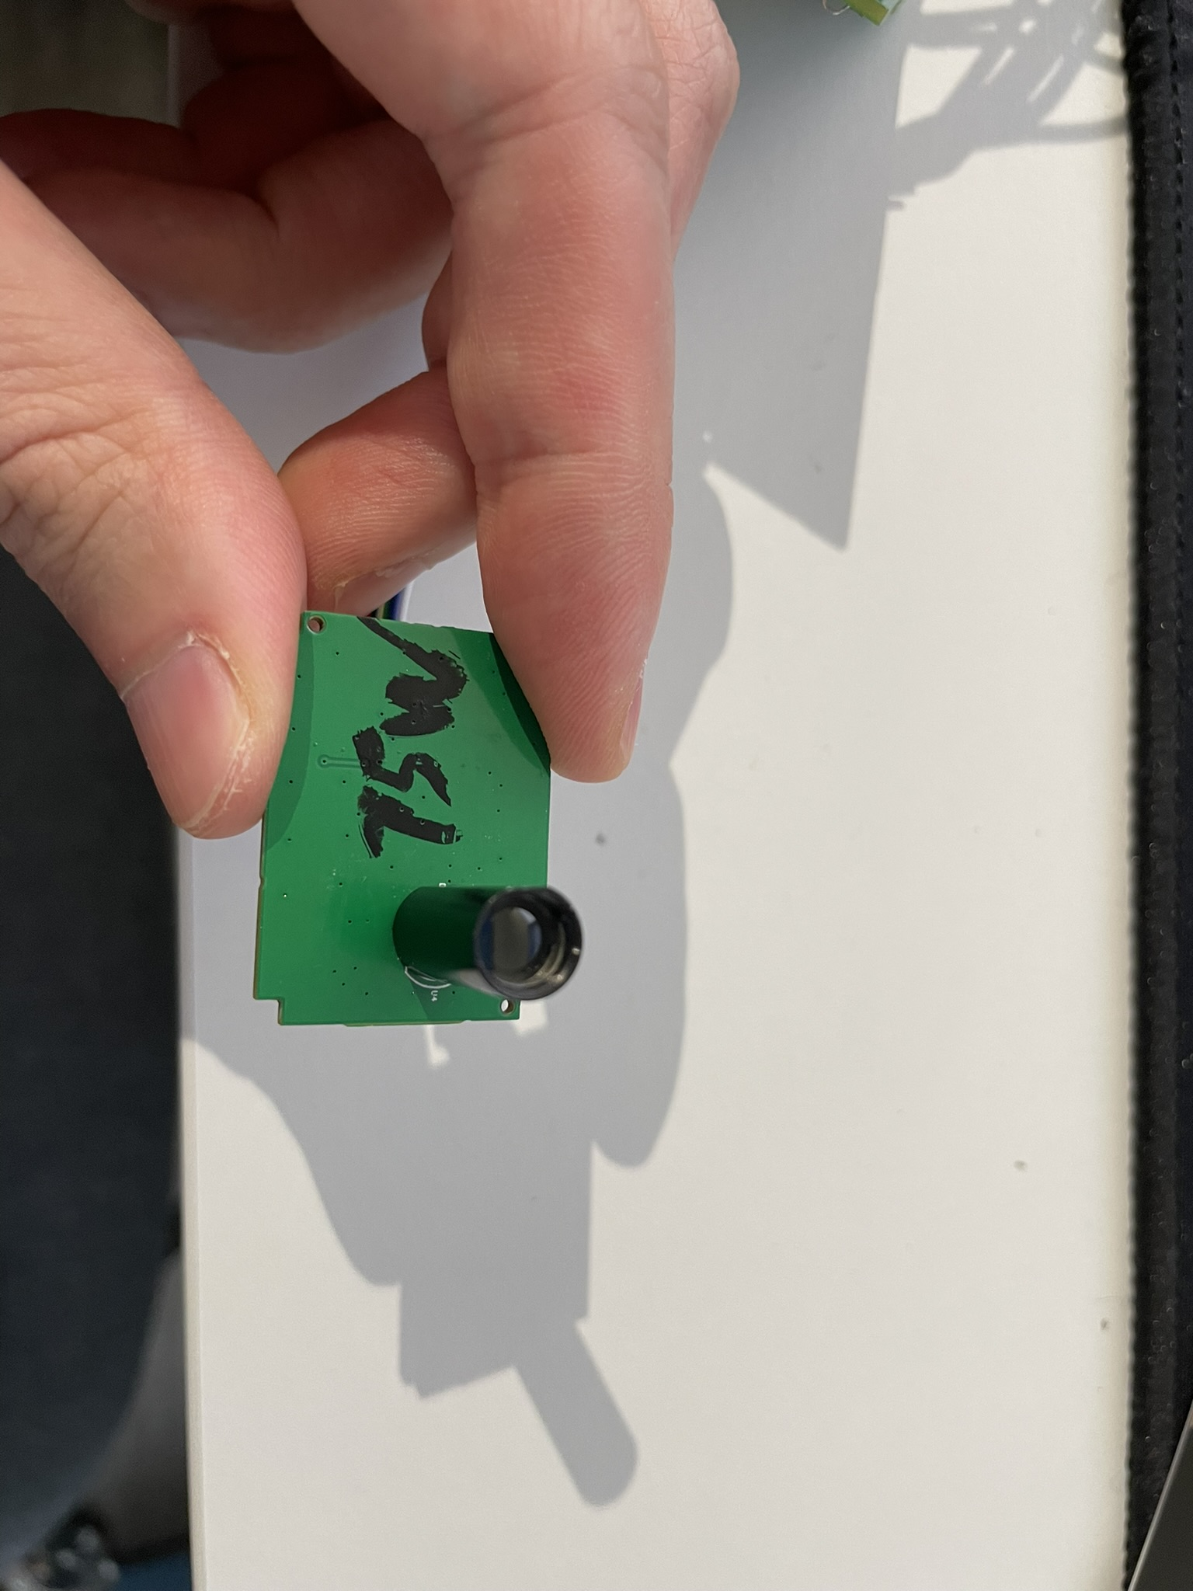
2、Pulse laser driver
Pulse laser driver circuit board, using collimated laser(905nm，75W)
Spots are seen on the laser viewing card

Slide 7
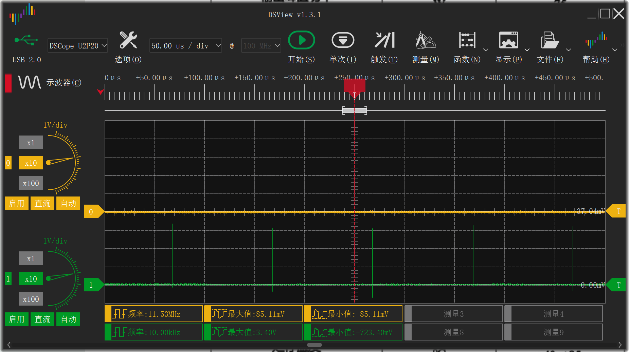
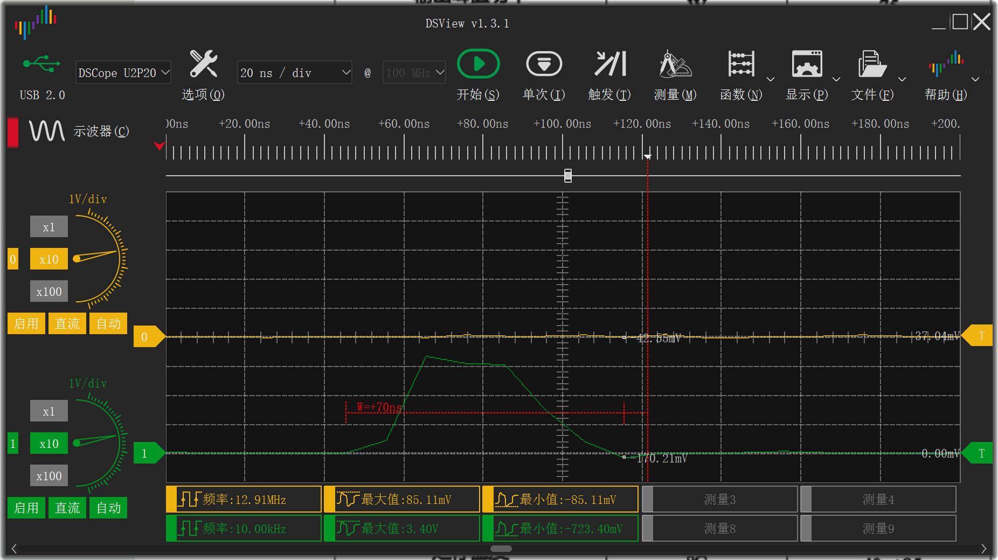
2、Pulse laser driver
Channel 1: Laser pulse control frequency10KHz
Channel 1: Laser pulse control pulse width is 40ns, the minimum can be controlled to 10ns

Slide 8
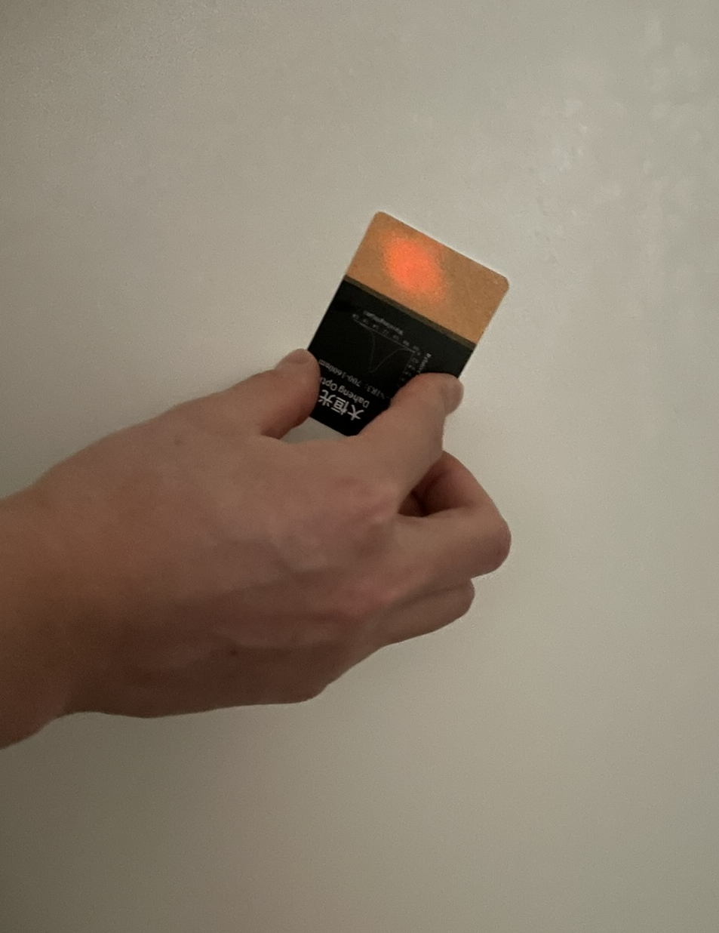
2、Pulse laser driver
The light spot diameter is about 2cm from a distance of about 5 meters.

Slide 9
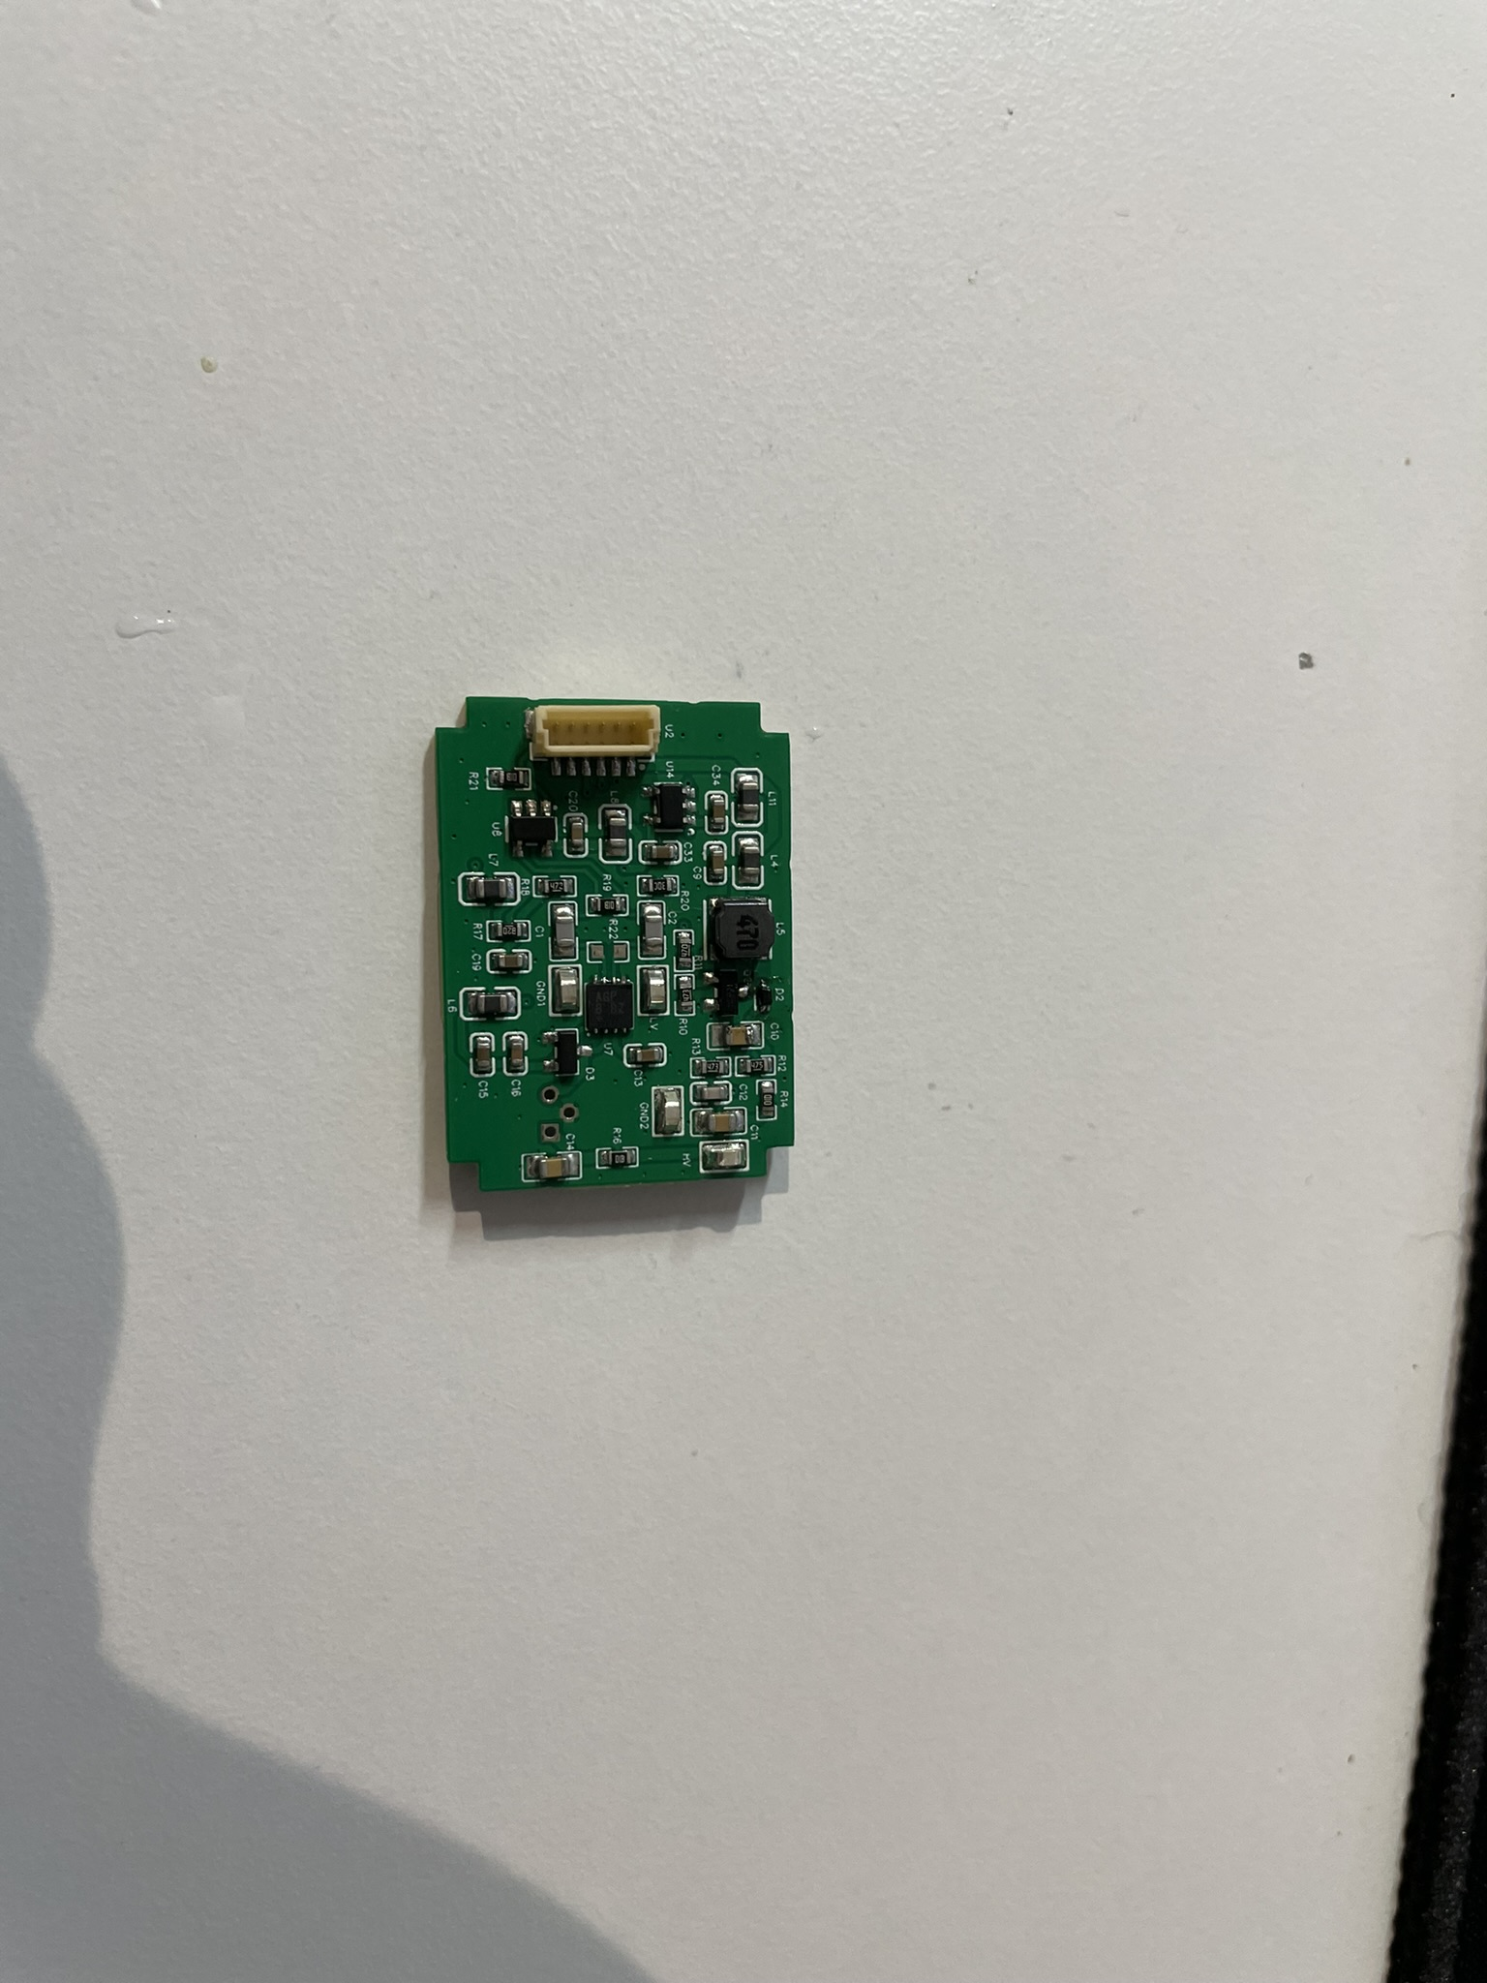
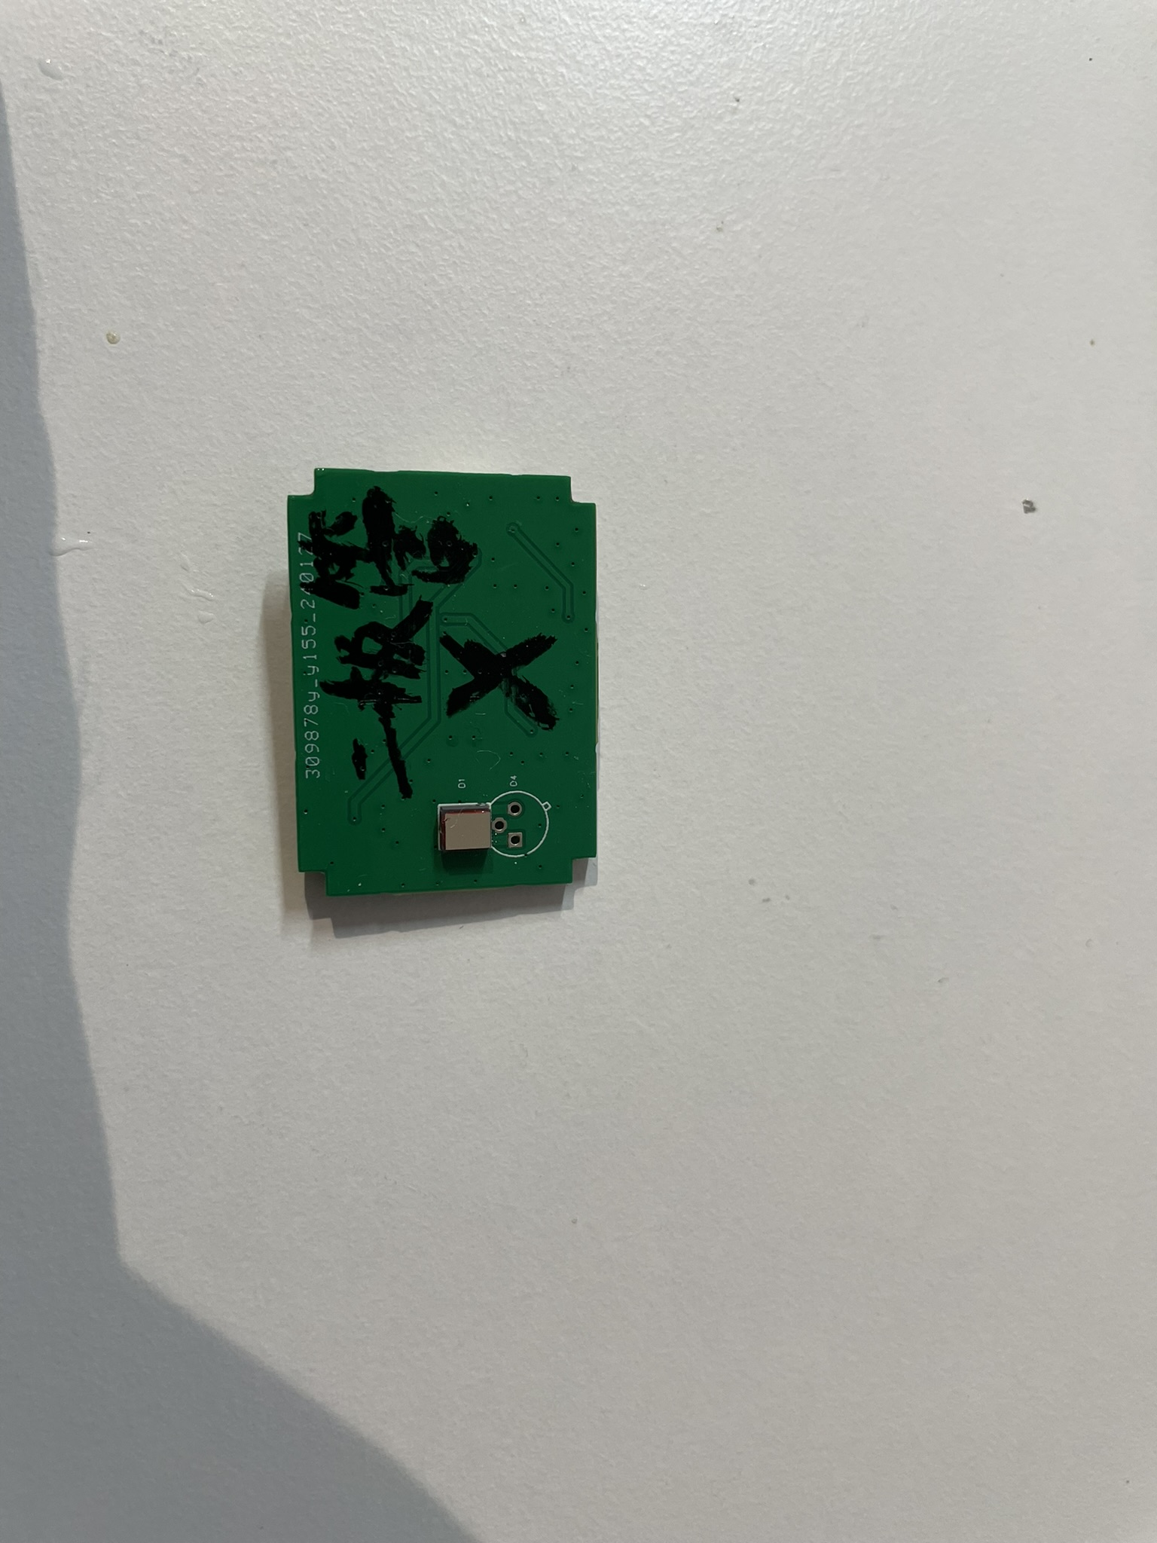
3、APD detector
APD detector part

Slide 10
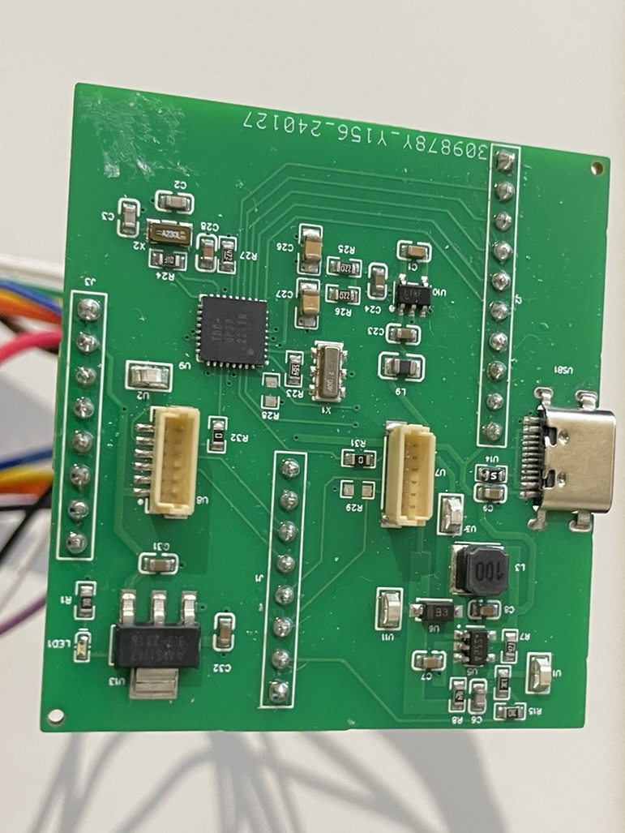
4、TDC driver
The TDC driver board is mainly responsible for the flight time measurement of transmitting and receiving signals.；
Connect the core board at the same time to control all input and output signals；
Powers the system and high-voltage modules。

Slide 11
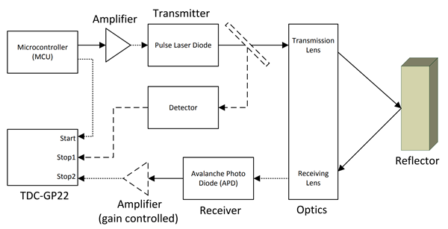
5、Preliminary assembly and testing
System overview

Slide 12
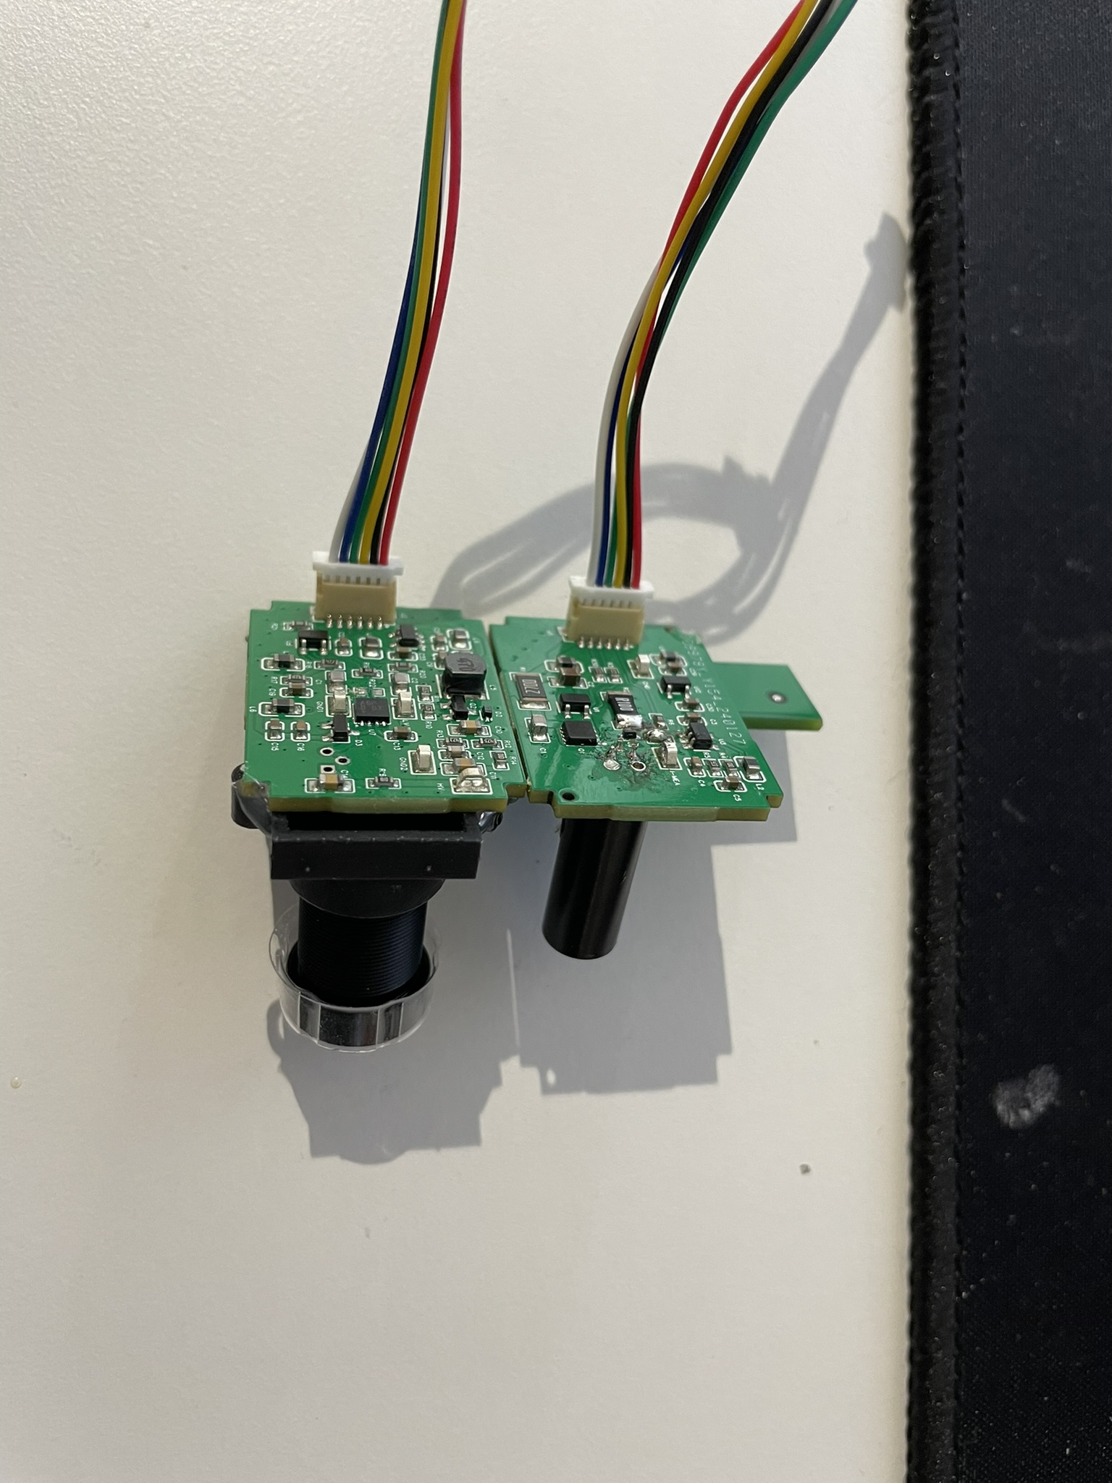
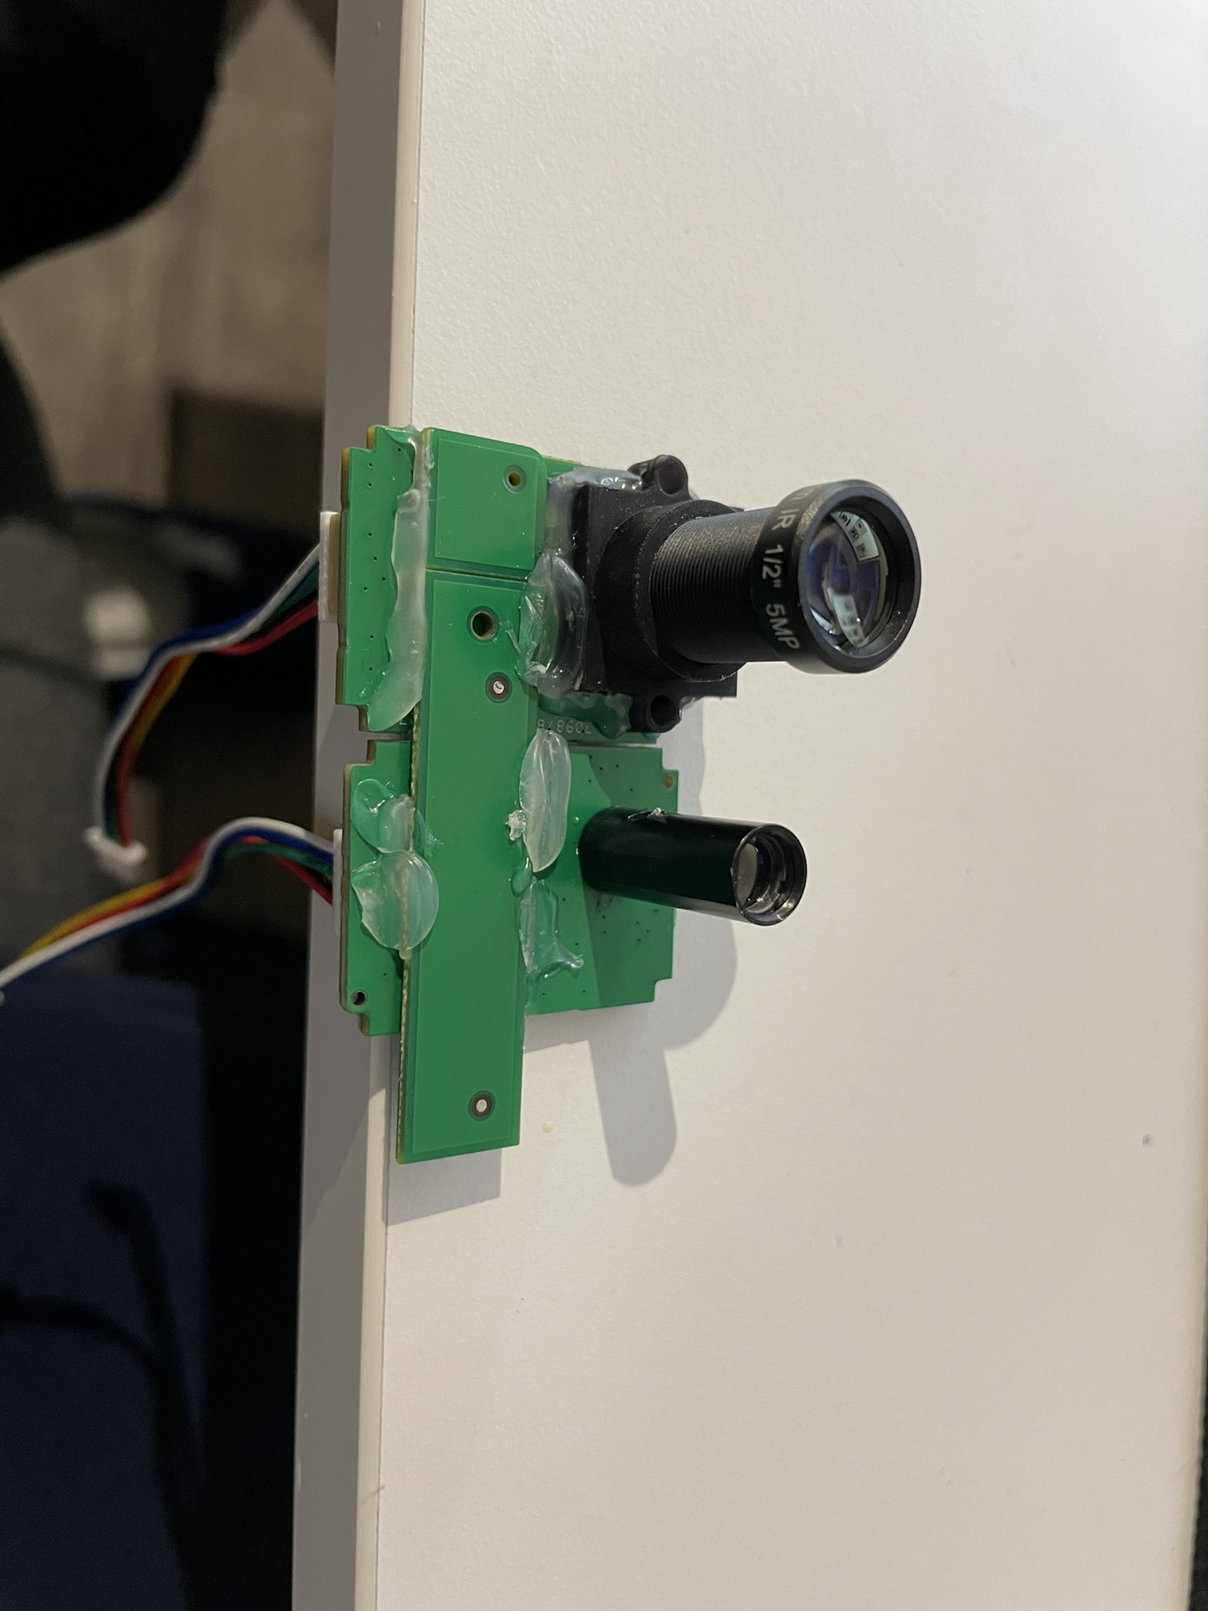
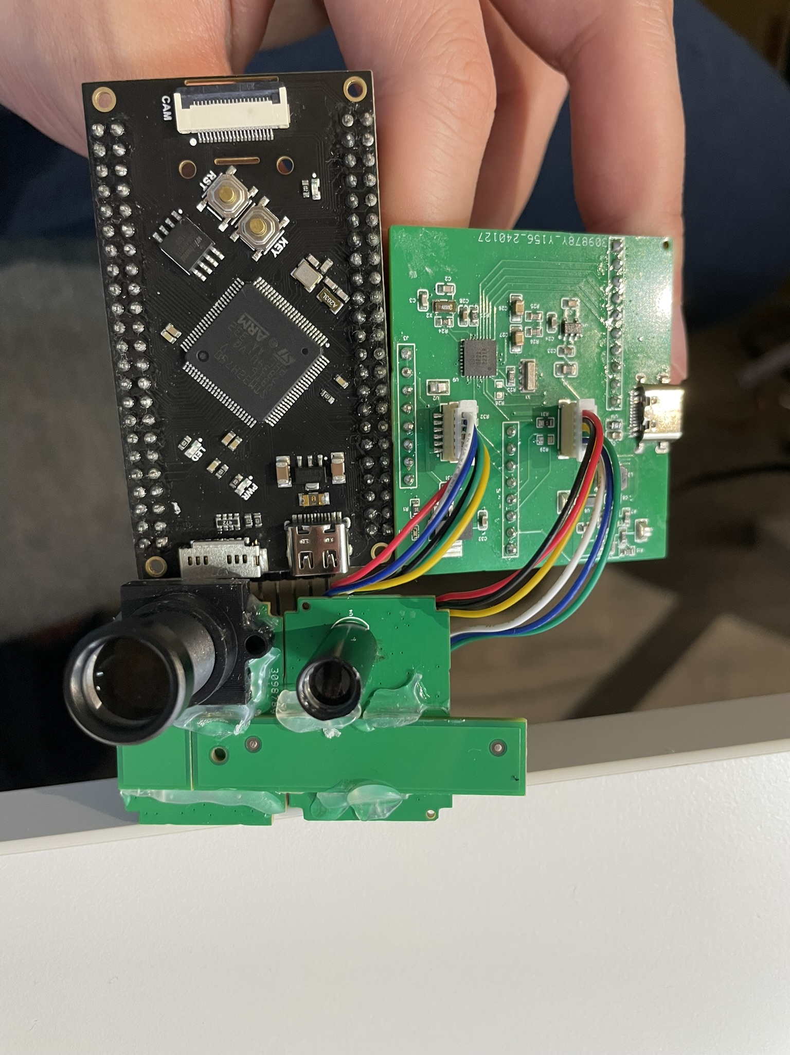
5、Preliminary assembly and testing

Slide 13
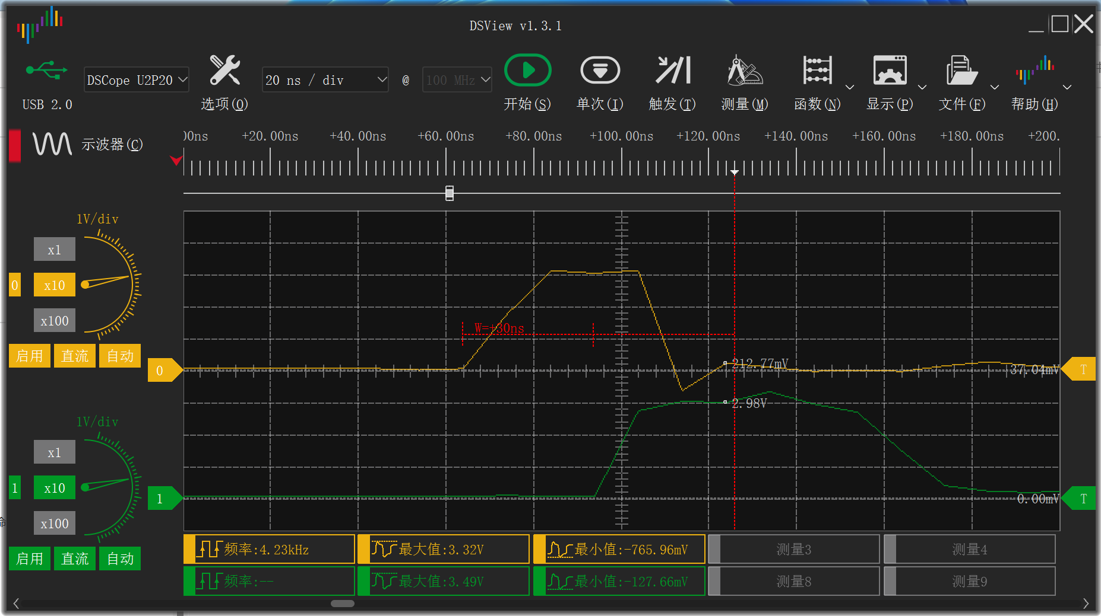
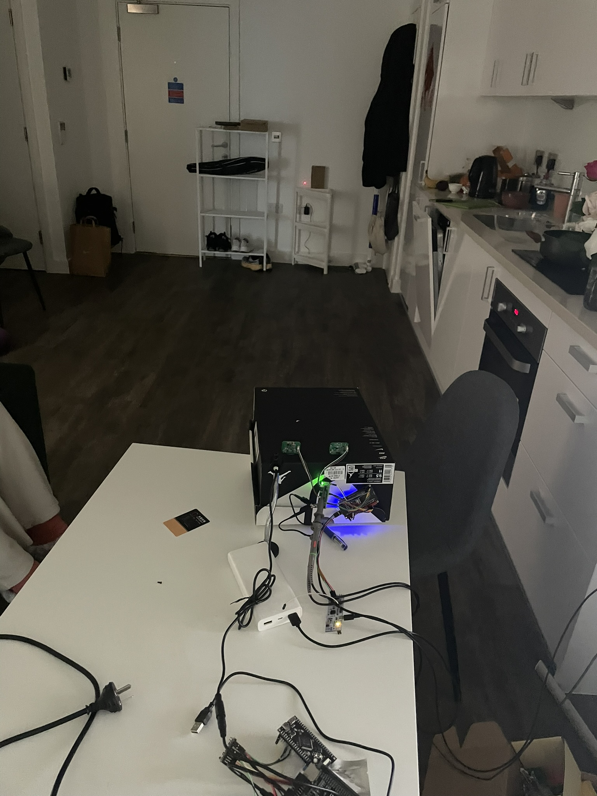
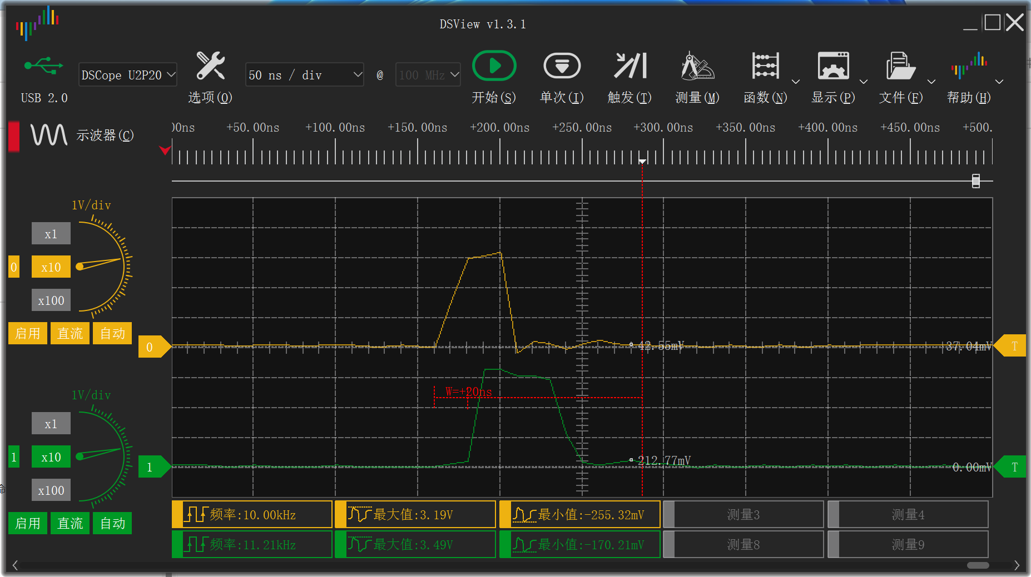
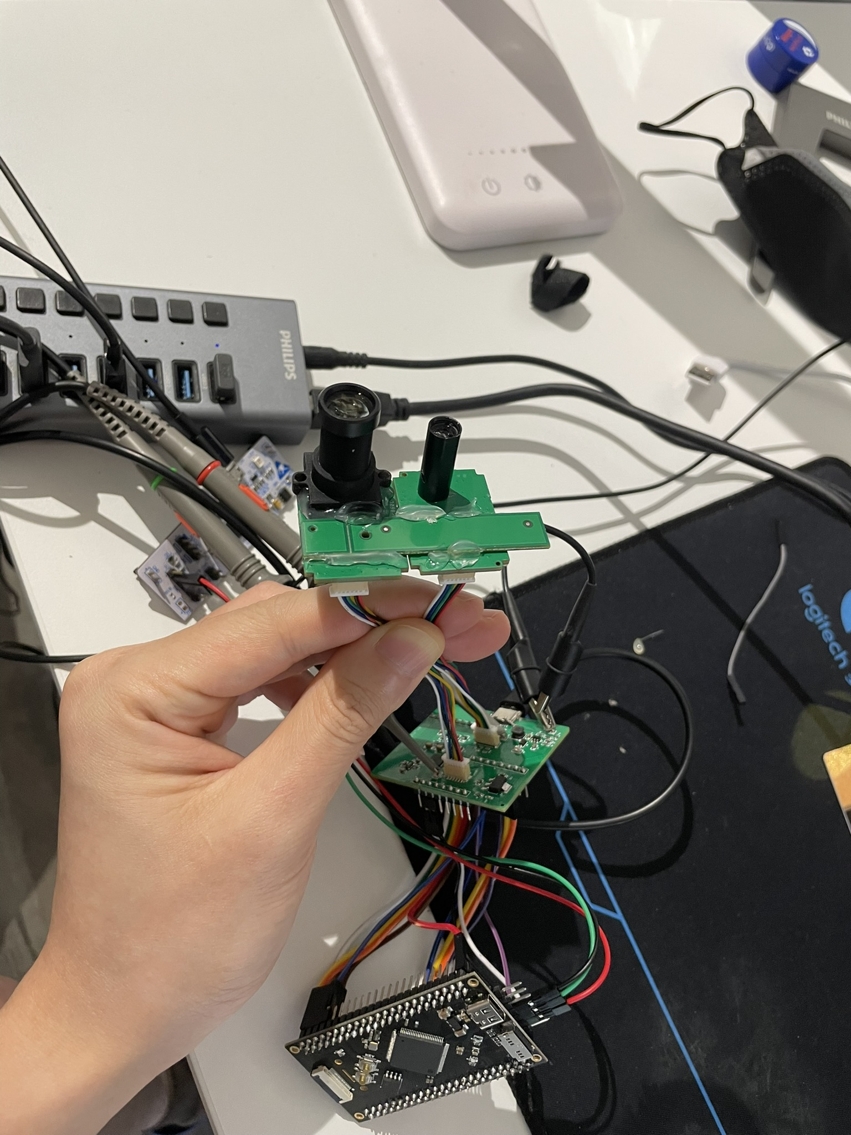
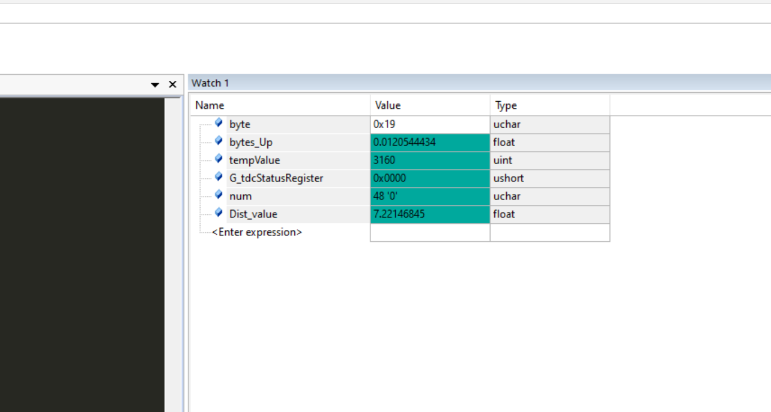
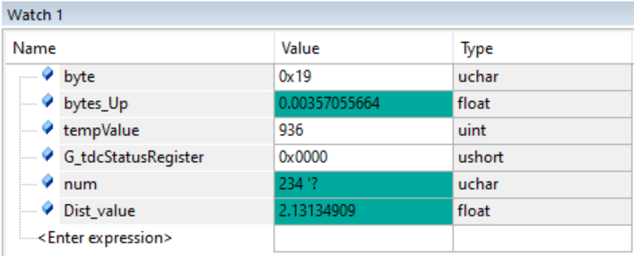
5、Preliminary assembly and testing
Aim at the door
Aim at the ceiling
In the picture in the upper left corner, the yellow line is the start signal of laser emission, and the green line is the APD receiving signal; the number in the red box in the lower left corner is the calculated distance, unit: meter.
The measurement was performed without calibration. The received light intensity was stable and the jitter after measuring the average value of the distance value was relatively small. However, calibration was not performed; the Walk error mentioned on the next page was not considered yet.

Slide 14
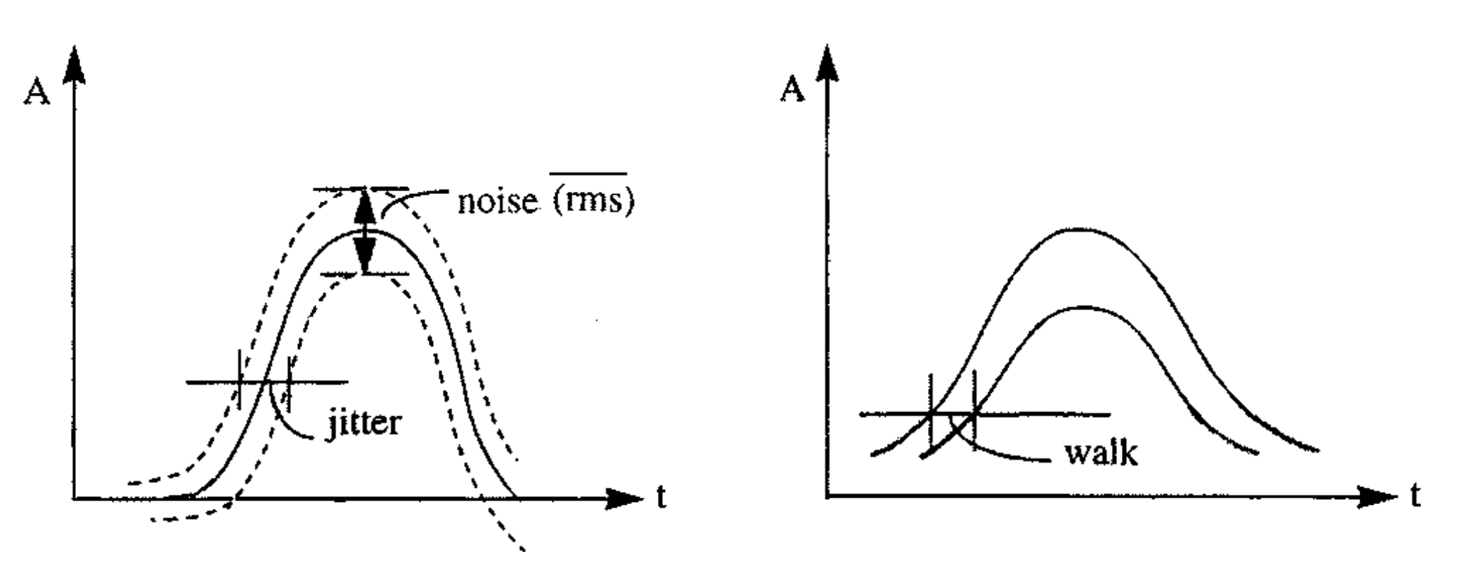
6、Walk error correction
Time-of-flight lidar systems measure pulse-return time of arrival based on the transition of the pulse return’s rising edge through a detection threshold. These systems are subject to systematic range error, termed range walk, caused by variations in pulse-return amplitude: For two otherwise identical pulse returns of differing amplitude that are both strong enough to exceed a fixed detection threshold, the rising edge of the weaker pulse return will cross the threshold at a time closer to the center of the pulse than the rising edge of the stronger pulse return.

Slide 15
7、To be continued
Thanks for watching!
https://github.com/SeerLikeJazz/LiDAR_TDC
https://github.com/SeerLikeJazz/MEMS_mirror_control_firmware
https://github.com/SeerLikeJazz/Mems-Lidar-GraphicFrame
Personal website: https://seerlikejazz.github.io/

